Slide 1

Oracle 11g: SQL
Chapter 13
Views

Slide 2
Objectives
Create a view by using CREATE VIEW command or the CREATE OR REPLACE VIEW command
Employ the FORCE and NOFORCE options
State the purpose of the WITH CHECK OPTION constraint
Explain the effect of the WITH READ ONLY option
Update a record in a simple view
Re-create a view
Explain the implication of an expression in a view for DML operations
Oracle 11g: SQL

Slide 3
Objectives (continued)
Update a record in a complex view
Identify problems associated with adding records to a complex view
Identify the key-preserved table underlying a complex view
Drop a view
Explain inline views and the use of ROWNUM to perform a “TOP-N” analysis
Create a materialized view to replicate data
Oracle 11g: SQL

Slide 4
Views
Permanent objects that store no data
Stores a query for re-use
Two purposes
  Reduce complex query requirements
    Commonly joined tables
    Routine calculations
  Restrict users’ access to sensitive data
Oracle 11g: SQL

Slide 5
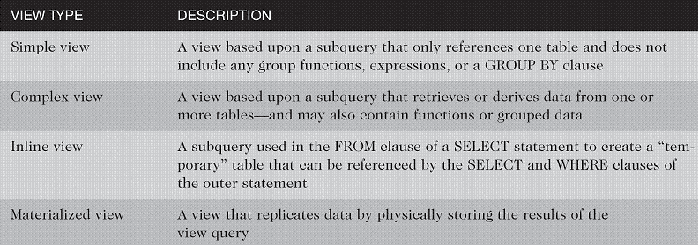
Types of Views
Oracle 11g: SQL

Slide 6

Creating a View
You use the CREATE VIEW keywords to create a view
Use OR REPLACE if the view already exists
Use FORCE if the underlying table does not exist at the time of creation
Provide new column names if necessary
Oracle 11g: SQL

Slide 7
Creating a View (continued)
WITH CHECK OPTION constraint – if used, prevents data changes that will make the data subsequently inaccessible to the view
WITH READ ONLY – prevents DML operations
Oracle 11g: SQL

Slide 8

Creating a Simple View
Only references one table – no group functions, GROUP BY clause, or expressions
Oracle 11g: SQL

Slide 9
DML Operations on a Simple View
Any DML operations are allowed through simple views unless created with WITH READ ONLY option
DML operations that violate constraints (esp. NOT NULL) on the underlying table are not allowed
Oracle 11g: SQL

Slide 10

Creating a Complex View
A complex view may contain data from multiple tables or data created with the GROUP BY clause, functions, or expressions
Type of DML operations allowed depends on various factors
Oracle 11g: SQL

Slide 11
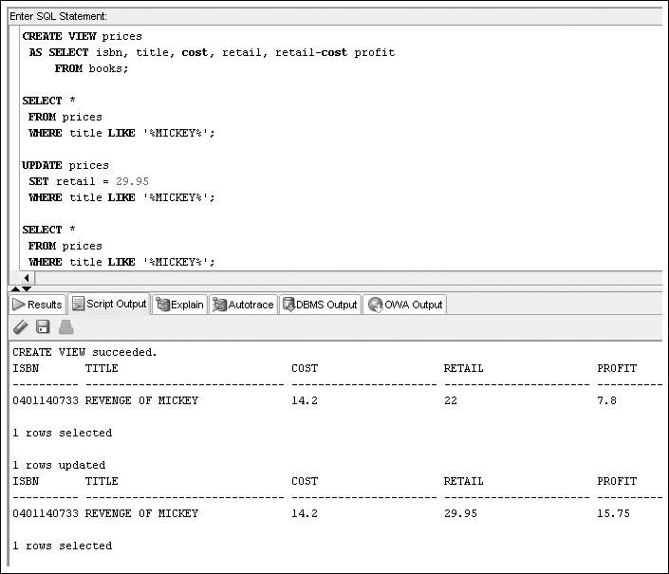

Slide 12
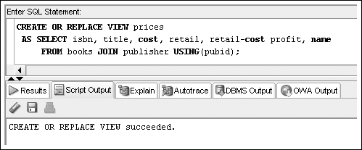
DML Operations on a Complex View Containing Data from Multiple Tables
DML operations cannot be performed on non-key-preserved tables, but they are permitted on key-preserved tables
Oracle 11g: SQL

Slide 13
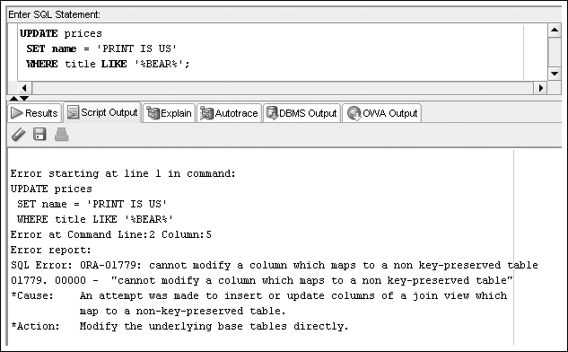
Oracle 11g: SQL

Slide 14
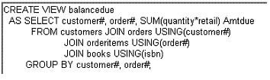
DML Operations on a Complex View Containing Functions or Grouped Data
DML operations are not permitted if the view includes a group function or a GROUP BY clause
Oracle 11g: SQL

Slide 15
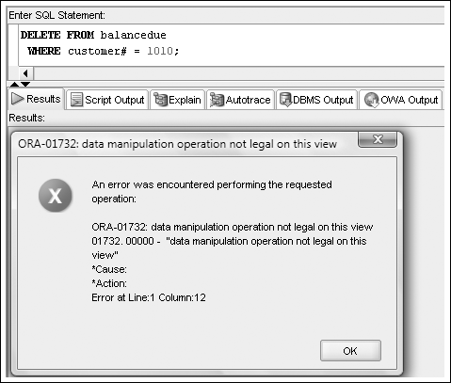
DML Operations on a Complex View Containing Functions or Grouped Data
Oracle 11g: SQL

Slide 16
DML Operations on a Complex View Containing DISTINCT or ROWNUM
DML operations on a view that contains the DISTINCT keyword or ROWNUM are not permitted
Oracle 11g: SQL

Slide 17
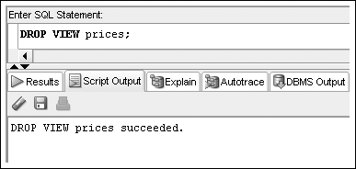
Dropping a View
Oracle 11g: SQL

Slide 18
Creating an Inline View
An inline view is a temporary table created by using a subquery in the FROM clause
It can only be referenced while the command is being executed
Most common usage – “TOP-N” analysis
Oracle 11g: SQL

Slide 19
“TOP-N” Analysis
ORDER BY included to identify top values:
  Descending for highest values
  Ascending for lowest values
Extract data based on ROWNUM
Oracle 11g: SQL

Slide 20
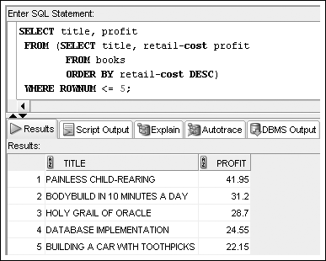
“TOP-N” Analysis (continued)
Oracle 11g: SQL

Slide 21
Materialized Views
Store data retrieved from view query
Referred to as “snapshots”
Similar effect to a CREATE TABLE … AS …
Oracle 11g: SQL

Slide 22
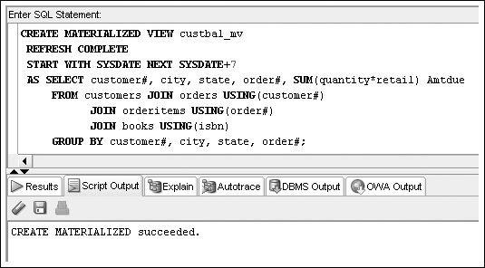
Materialized Views (continued)
Oracle 11g: SQL

Slide 23
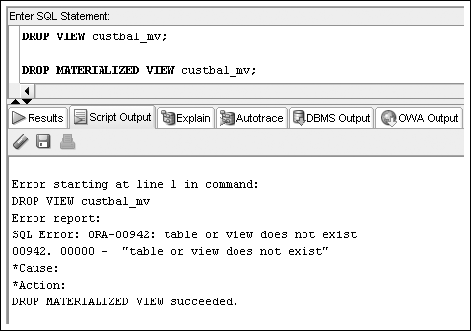
Materialized Views (continued)
Oracle 11g: SQL

